Slide 1
Erasmus+ 2021-2027 Work together with European higher education institutions
2022 Erasmus+ Call, Info-session
European Education and Culture Executive Agency

Slide 2
What is Erasmus+?
The EU's programme supports education, training,
youth and sport
Funding for programmes, projects and scholarships
Fosters EU-EU and EU-international cooperation
Erasmus+ programme 2021-2027 over €26,2 billion to support mobility and learning for all, across the European Union and beyond:
builds on previous programme (2014-2020)
more international
Notes:
Erasmus+ is a wide programme, which started over 30 years ago with intra-European projects to boost internationalization across Europe’s borders.
Since 2014, Erasmus+ has acknowledged the need to boost internationalization at world level.
The previous programme 2014-2020 had a strong international dimension, supporting projects for cooperation or exchange between Europe and the rest of the world.
In the current programme 2021-2027, the international dimension of Erasmus+ will be further strengthened, building on the success of the existing key actions and expanding international to other sectors.

Slide 3
Responsibility
European Commission
European Education and Culture Executive Agency (EACEA)

Slide 4
International dimension of Erasmus+ 2021-2027
Programme countries => Member States and associated
third countries
Partner countries =>
Non-associated third countries
Notes:
Erasmus+ international projects in the area of higher education are based on partnerships between European organisations and those in other parts of the world.
On the European side, this means the EU Member States plus other countries that have associated to the Programme. At present this means 33 countries: the 27 EU Member States plus six other countries outside the EU, but which have a National Agency and contribute to the programme: Iceland, Liechtenstein, Norway, Serbia, North Macedonia and Turkey.
The UK is no longer an EU Member State and has opted not to associate to Erasmus+ in this phase of the programme.
Defensive – if asked
This means it can only take part in Erasmus Mundus and Jean Monnet activities.
Partner Countries are all other countries throughout the world, who also benefit from our programmes. In the new programme they will be referred to as non-associated third countries.

Slide 5
33 Programme countries => EU Member States and associated third countries
27: Austria, Belgium, Bulgaria, Croatia, Cyprus, Czech Republic, Denmark, Estonia, Finland, France, Hungary, Germany, Greece, Ireland, Italy, Latvia, Lithuania, Luxembourg, Malta, The Netherlands, Poland, Portugal, Romania, Slovakia, Slovenia, Spain, Sweden
6: Norway, Iceland, Macedonia, Serbia, Liechtenstein, Turkey

Slide 7
Regions
Western Balkans (Region 1) | Albania, Bosnia and Herzegovina, Kosovo, Montenegro
Neighbourhood East (Region 2) | Armenia, Azerbaijan, Belarus, Georgia, Moldova, Territory of Ukraine as recognised by international law
South-Mediterranean countries (Region 3) | Algeria, Egypt, Israel, Jordan, Lebanon, Libya, Morocco, Palestine, Syria, Tunisia
Russian Federation (Region 4) | Territory of Russia as recognised by international law
Asia (Region 5) | Bangladesh, Bhutan, Cambodia, China, DPR Korea, India, Indonesia, Laos, Malaysia, Maldives, Mongolia, Myanmar, Nepal, Pakistan, Philippines, Sri Lanka, Thailand and Vietnam High income countries: Brunei, Hong Kong, Japan, Korea, Macao, Singapore and Taiwan
Central Asia (Region 6) | Afghanistan, Kazakhstan, Kyrgyzstan, Tajikistan, Turkmenistan, Uzbekistan
Middle East (Region 7) | Iran, Iraq, Yemen High income countries: Bahrain, Kuwait, Oman, Qatar, Saudi Arabia, United Arab Emirates
Pacific (Region 8) | Cook Islands, Fiji, Kiribati, Marshall Islands, Micronesia, Nauru, Niue, Palau, Papua New Guinea, Samoa, Solomon Islands, Timor-Leste, Tonga, Tuvalu, Vanuatu High income countries: Australia, New Zealand
Sub-Saharan Africa (Region 9 ) | Angola, Benin, Botswana, Burkina Faso, Burundi, Cameroon, Cabo Verde, Central African Republic, Chad, Comoros, Congo, Congo - Democratic Republic of the, Côte d’Ivoire, Djibouti, Equatorial Guinea, Eritrea, Eswatini, Ethiopia, Gabon, Gambia, Ghana, Guinea, Guinea-Bissau, Kenya, Lesotho, Liberia, Madagascar, Malawi, Mali, Mauritania, Mauritius, Mozambique, Namibia, Niger, Nigeria, Rwanda, Sao Tome and Principe, Senegal, Seychelles, Sierra Leone, Somalia, South Africa, South Sudan, Sudan, Tanzania, Togo, Uganda, Zambia, Zimbabwe
Latin America (Region 10) | Argentina, Bolivia, Brazil, Chile, Colombia, Costa Rica, Ecuador, El Salvador, Guatemala, Honduras, Mexico, Nicaragua, Panama, Paraguay, Peru, Uruguay and Venezuela
Caribbean (Region 11) | Antigua & Barbuda, Bahamas, Barbados, Belize, Cuba, Dominica, Dominican Republic, Grenada, Guyana, Haiti, Jamaica, St Kitts and Nevis, St Lucia, St Vincent & Grenadines, Suriname and Trinidad & Tobago

Slide 8
Opportunities for HE institutions from non-associated third countries
ICM: International Credit Mobility
EMJM/EMDM: Erasmus Mundus Joint Masters &
Erasmus Mundus Designed Measures (NEW)
CBHE: Capacity Building for Higher Education
CBVET: Capacity Building for VET (NEW)
JMA: Jean Monnet activities
VE: Virtual Exchanges (NEW)
Notes:
All these opportunities existed in the 2014-20 programme, so there is a solid base of successful cooperaiton to build on.
So the key message is continuity.
International credit mobility is focused on two-way exchange of students and staff.
Capacity-Building and Jean Monnet activities are more about academic cooperation and teaching.
Erasmus Mundus is both – joint degree programmes with scholarships.
We'll look at each in turn.
International credit mobility and Capacity-Building are financed with the EU’s budget for international cooperation. This will only feed in to the 2022 selection.

Slide 9
International credit mobility
Notes:
International credit mobility projects are based on bilateral agreements between universities in Europe and universities in other parts of the world. They agree to send and host each other's students and staff.

Slide 10
International Credit Mobility (ICM) Staff and student exchange
Short-term studies or traineeships abroad bachelor, master and doctoral level that count to a degree back home
2-12 months for students; 5-30 days in case of blended mobility
5 days – 2 months for staff
Traineeships open to recent graduates too
Grants to cover travel and living costs
a min. of 40% of the budget should be allocated to students with fewer opportunities (reference https://inclusivemobility.eu)
HEIs from EU MS and associated third countries may apply to their National Agency
Notes:
SCOPE, AND REGIONS STILL TO BE FINALISED FOR INCLUSION IN THE 2022 CALL
These agreements can move students for study, students for traineeships, and staff.
Mobility can be in either direction.
The projects are proposed by European universities.
Each European country will have a budget for its universities to fund mobility agreements with scholarships for all regions of the world. European universities apply to their national agencies.
The funding covers:
Living costs for individuals
Contribution to travel costs for individuals
An ‘operating cost’ allowance per invidiual paid to the partnership to cover the costs of running the partnership.
There are no fees covered in the grant – the two sides agree to waiver any participation costs.
Universities in non-associated third countries (outside Europe) should therefore talk to the European academic contacts they have about planning mobility with Erasmus+
Each European country will have budget to cooperate with each part of the world.

Slide 11
Erasmus Mundus Joint Masters
Notes:
These are joint master programmes awarding a degree, with study in two or more of the universities in the partnership, in different countries. The EU funds full EU-funded scholarships, open to everybody worldwide. Students do not have to be registered at a partner university.

Slide 12
Erasmus Mundus Joint Masters (EMJM) submission of a joint master programme by the consortium
Excellent integrated Master courses offered by consortia of three full partner HEIs from three different countries, of which at least two must be EU Member States or Associated third countries accredited, innovative, compulsory mobility of students
Attract best students worldwide through EU-funded scholarships
Duration: 6 academic years covering at least 4 editions of the master programme
1 to 2 academic years (60, 90 or 120 ECTS credits) with study in 2+ countries, of which at least one must be an EU MS or Associated third country
Institutions from all over the world may submit a proposal on behalf of an international consortium
Notes:
-- Erasmus Mundus for universities
Jointly designed and fully integrated curriculum
Offered by a consortium. Needs at least three higher education institutions. At least two have to be from EU + associate countries.
Curriculum must include at least two study periods in two countries. At least one of these countries must be an EU + associate country. CHANGE: Before, required 2 periods in EU+assoc countries
EU funds the projects in two forms:
The cost of up to 60 scholarships that the consortium can award in four annual student selections. Students receive a scholarship of EUR 1400 x number of months of course, typically EUR 33,600.
A ‘management’ component: EUR 750 per enrolled student
An application to run a programme can be submitted on behalf of the consortium by an HEI from anywhere in the world (CHANGE: Before only from Europe)
An EMJMD can involve partner universtities from partner countries (but this is not essential).
-- Erasmus Mundus for students
Students apply annually at the same time of year, e.g. October 2020 – February 2021 to scholarships for programmes starting in September/October 2021. Students apply directly to the course, which can be found on the Erasmus+ website.
http://eacea.ec.europa.eu/erasmus-plus/library/scholarships-catalogue_en

Slide 13
Erasmus Mundus Design Measures (EMDM)
New sub-action, supporting the design of high-level study programmes at master level
An EM Design Measures project involves at least 3 full partner HEIs from three different countries, of which at least two must be EU Member States or Associated third countries
Independent call for proposals
Fixed duration of 15 months
55 000 EUR lump sum
Institutions from all over the world may submit a proposal on behalf of an international consortium
Notes:
Erasmus Mundus Design Measures is a new sub-action, which supports institutions to set-up a new joint master programme.
They are jointly delivered by an international partnership of HEIs from different countries worldwide and, where relevant, other educational and/or non-educational partners with specific expertise in the concerned study areas/professional domains.
The EM Design Measures is an independent funding scheme from EMJM and has independent call for proposals.
The EU Grant takes the form of single lump sum contribution of 55.000 Euros for costs linked to the activities necessary to set up the new joint master programme.
The expected outcomes of these projects are:
Joint programme design and joint procedures
Joint administrative and financial management
Common services offered to students
Joint promotion and dissemination
A draft joint Partnership and Student Agreement
A joint degree policy and launch of accreditation process
+ explore opportunities offered by the European Approach for Quality Assurance of Joint Programmes (if national legislation allows)

Slide 14
Jean Monnet activities
Focus on European integration studies
Teaching and research
Modules (30 000 EUR) 40 hours
Chairs (50 000 EUR) 90 hours
Centres of Excellence (100 000 EUR)
Policy debate with academic world
Networks
Notes:
Jean Monnet activities provide grants to universities and professors to teach and spread knowledge about studies of European integration. They are open to institutions worldwide.
Jean Monnet projects are individual projects. As a partner-country university you do not need European partners.
This programme is aimed to support the development of teaching materials, professorships or chairs to teach European studies, or centres of excellence within universities that spread information about European integration to a wider audience.
Jean Monnet Modules are short teaching programmes or courses on EU studies at Higher Education Institutions. They are organised by one researcher/professor and may also call for the participation of colleagues and experts, they can be introductory modules on the EU, courses that concentrate on a specific aspect or discipline within EU studies, or be more multi-disciplinary in approach. They last 3 years.
Jean Monnet Chairs are teaching posts in EU studies for university professors. They last 3 years.
Centres of Excellence are focal point of competence and knowledge on European Union subjects. The Centres on top of their research activities have also major role in reaching out to students from faculties not normally dealing with European Union issues as well as to policy makers, civil servants, organised civil society and the general public. They last 3 years.
Jean Monnet Projects and Networks will be launched later.

Slide 15
Virtual Exchanges in HE and Youth
Online people-to-people activities promoting intercultural dialogue and soft skills development
Small groups moderated by trained facilitators
HEIs and / or NGOs (formal and/or non-formal education)
Online discussions, trainings, course delivery
Max. 500 000 EUR

Slide 16
Who can apply?
 | Institutions from EU MS and associated third countries | Institutions from non-associated third countries
International credit mobility Applications to National Agencies | Applicant Partner | Partner
EMJM and EMDM Applications to EACEA | Applicant Partner | Applicant Partner
CBHE Applications to EACEA | Applicant Partner | Applicant (eligible regions) Partner
Jean Monnet activities Applications to EACEA | Applicant Partner | Applicant Partner
Virtual Exchanges Applications to EACEA | Applicant Partner | Partner

Slide 17
Re-cap: when to apply for what?
Action | Deadline for submission of applications | Budget (approx.)
Erasmus Mundus Joint Masters Erasmus Mundus Design Measures | 16 February 2022 | 110m EUR (H2) + 25m EUR (H6) ~ 27 EMJM projects ~ 55 EMDM projects
Capacity Building for Higher education | 17 February 2022 | 103m EUR
Virtual Exchanges | 22 February/ 20 September 2022
International credit mobility | 23 February 2022 | 194m EUR
Jean Monnet activities | 1 March 2022 | ~19m EUR (JM in the field of HE + JM policy debate incl. for other levels of education and training not open to non-associated third countries)
Capacity Building in VET | 31 March 2022

Slide 18
Capacity Building for VET
Multilateral partnerships between organisations active in vocational education & training
Build links and networks, increase capacities and skills, develop new programmes and courses
Partnership of at least four partners from min three countries, including at least one third country
Regions involved (priorities differ per region) Duration: 12, 24 or 36 months
Western Balkans Min. 100 000 EUR Max. 400 000 EUR
Eastern Partnership
Latin America and Caribbean
Sub-Saharan Africa
Notes:
This action supports multilateral partnerships of organisations active in the field of VET in EU or associated countries, and other countries. They aim to support the relevance, accessibility, and responsiveness of VET institutions and systems in these third countries as a driver of sustainable socio-economic development. The action is open to the following regions: Sub-Saharan Africa, Russia, South Mediterranean, Eastern Partnership, the Western Balkans and Latin America.
For more information: Erasmus+ website
Key messages for organisations active in the field of VET
• Beyond higher education, Erasmus+ is also supporting the international cooperation of VET stakeholders. Getting inspiration and support from your peers beyond borders is a real plus.
• Participating in such capacity building projects can support your VET organisation in improving its curriculum and better fit to the local labour market needs.
• Participating in such capacity building projects raises the quality of teaching in your VET organisation and motivates your staff.
• Participating in such capacity building projects can attract new and motivated learners and improve their employability.
• Beyond VET providers, such projects are open to a public or private organisations active in the field of VET allowing your organisation to better connect with its local natural partners.
• As the applicant must be located in Europe (EU MS or associated countries), the first step is to contact your partners there and prepare an application with them.

Slide 19
GUIDE
https://erasmus-plus.ec.europa.eu/sites/default/files/2021-11/2022-erasmusplus-programme-guide.pdf

Slide 20
More information
Erasmus+ Programme guide
Erasmus+ Call for proposals
ErasmusPlus Facebook
ErasmusPlus Twitter

Slide 21
THANK YOU
National Erasmus+ Office in Armenia
Tel.: +374 91216258
neo@erasmusplus.am
program@erasmusplus.am
info@erasmusplus.am
www.erasmusplus.am
neoarm
@ErasmusArmenia

Slide 22
Capacity Building in Higher Education (CBHE)
2022 Erasmus+ Call, Info-Day
European Education and Culture Executive Agency

Slide 24
Regions
Western Balkans (Region 1) | Albania, Bosnia and Herzegovina, Kosovo, Montenegro
Neighbourhood East (Region 2) | Armenia, Azerbaijan, Belarus, Georgia, Moldova, Territory of Ukraine as recognised by international law
South-Mediterranean countries (Region 3) | Algeria, Egypt, Israel, Jordan, Lebanon, Libya, Morocco, Palestine, Syria, Tunisia
Russian Federation (Region 4) | Territory of Russia as recognised by international law
Asia (Region 5) | Bangladesh, Bhutan, Cambodia, China, DPR Korea, India, Indonesia, Laos, Malaysia, Maldives, Mongolia, Myanmar, Nepal, Pakistan, Philippines, Sri Lanka, Thailand and Vietnam High income countries: Brunei, Hong Kong, Japan, Korea, Macao, Singapore and Taiwan
Central Asia (Region 6) | Afghanistan, Kazakhstan, Kyrgyzstan, Tajikistan, Turkmenistan, Uzbekistan
Middle East (Region 7) | Iran, Iraq, Yemen High income countries: Bahrain, Kuwait, Oman, Qatar, Saudi Arabia, United Arab Emirates
Pacific (Region 8) | Cook Islands, Fiji, Kiribati, Marshall Islands, Micronesia, Nauru, Niue, Palau, Papua New Guinea, Samoa, Solomon Islands, Timor-Leste, Tonga, Tuvalu, Vanuatu High income countries: Australia, New Zealand
Sub-Saharan Africa (Region 9 ) | Angola, Benin, Botswana, Burkina Faso, Burundi, Cameroon, Cabo Verde, Central African Republic, Chad, Comoros, Congo, Congo - Democratic Republic of the, Côte d’Ivoire, Djibouti, Equatorial Guinea, Eritrea, Eswatini, Ethiopia, Gabon, Gambia, Ghana, Guinea, Guinea-Bissau, Kenya, Lesotho, Liberia, Madagascar, Malawi, Mali, Mauritania, Mauritius, Mozambique, Namibia, Niger, Nigeria, Rwanda, Sao Tome and Principe, Senegal, Seychelles, Sierra Leone, Somalia, South Africa, South Sudan, Sudan, Tanzania, Togo, Uganda, Zambia, Zimbabwe
Latin America (Region 10) | Argentina, Bolivia, Brazil, Chile, Colombia, Costa Rica, Ecuador, El Salvador, Guatemala, Honduras, Mexico, Nicaragua, Panama, Paraguay, Peru, Uruguay and Venezuela
Caribbean (Region 11) | Antigua & Barbuda, Bahamas, Barbados, Belize, Cuba, Dominica, Dominican Republic, Grenada, Guyana, Haiti, Jamaica, St Kitts and Nevis, St Lucia, St Vincent & Grenadines, Suriname and Trinidad & Tobago

Slide 25
Selection involving EaP countries
Very competitive selection (13% success rate)
127 projects funded over 6 calls: 99 joint projects + 28 structural projects
Notes:
The EaP region gathers 6 ex-soviet countries (AM, AZ, BY, GE, MD, UA).
The overall CBHE selection is very competitive but this is particularly true for the EaP region, where there is a high interest in the action, and therefore a lot of applications, the applications are also of high quality, and the budget for the region is limited, and therefore we cannot fund all the applications considered of high quality.

Slide 26
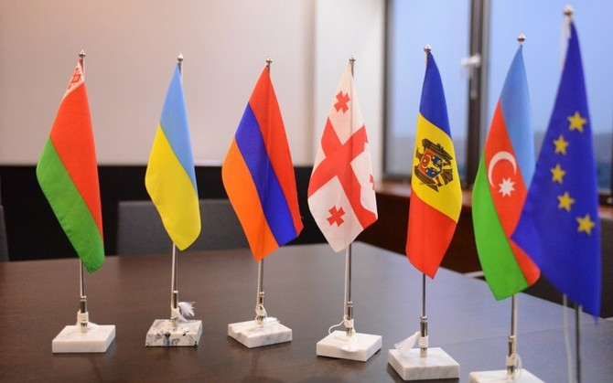
Eastern Partnership results 2015-2020
Armenia
30 projects
Georgia
37 projects
Moldova
29 projects
Belarus
24 projects
Azerbaijan
19 projects
Ukraine
48 projects
Notes:
Breakdown per country, number of projects in which each EaP country is involved
We see UA with highest nr of projects, due also to biggest HE system
Nr of projects not the only indicator because in some of the projects the participation of one or other country can be higher due to the high number of institutions involved

Slide 28
Context
The CBHE action supports the relevance, quality, modernisation and responsiveness of Higher Education institutions and systems in third countries not associated to the Erasmus + programme for socio-economic recovery, growth and prosperity.
It reacts to recent trends, in particular economic globalisation but also the recent decline in human development, fragility, and rising social, economic and environmental inequalities exacerbated by the COVID-19 crisis.
It is aligned with the ‘Sustainable Development Goals ‘(SDGs) and the Paris Agreement.
It puts focus on Inclusion, accessibility and equity

Slide 29
Objectives
Modernisation
HEIs & HE systems
Societal impact
CBHE
Cooperation/
Regional integration
Governance
Innovation
Accessibility

Slide 30
New features
Three strands
New budget system
a new type of support
Overaching & sub-priorities
Lump sum II
Regional priorities
New publication system

Slide 31
Three strands

Slide 32
Capacity Building for Higher Education (CBHE) 2-3 year Partnerships of HEIs from EU MS & associated third countries and non-associated third countries
Strand 1 - FOSTERING ACCESS TO COOPERATION IN HE
24-36 months, €200-400k
smaller scope projects focused on universities & LDCs – priority to newcomers
Strand 2 - PARTNERSHIPS FOR TRANSFORMATION IN HE
24-36 months, € 400-800k
larger-scale projects focused on innovation, university/business and governance
Strand 3 - STRUCTURAL REFORM PROJECTS
36-48 months, € 800-1000k
focus on policy reforms - require involvement of ministries (MESCS)
Notes:
SCOPE, AND REGIONS STILL TO BE FINALISED FOR INCLUSION IN THE 2022 CALL
CBHE projects are partnerships of European universities and those from other regions of the world.
The benefit should be mainly for the universities and/or higher education systems in partner countries. This is a cooperation and development type of project and therefore not available for "industrialised" regions (US, Japan, Australia etc).
These aim overall to:
Support modernisation & internationalisation
Improve quality
Improve the level of competences and skills
Enhance management, governance in HEIs
Promote people-to-people contacts, intercultural understanding
Voluntary convergence with EU HE policy developments
Contribute to overarching EU prioty policies (green transition, digital transformation etc)
Three types of project:
FOSTERING ACCESS TO COOPERATION IN HE: smaller scope projects focsued in universities – prority to newcomers, less involved countries /regions, disadvantaged targed groups. €200-400k
PARTNERSHIPS FOR INNOVATION IN HE: larger-scale projects focused on innovation, university/business and HE institutional governance. € 400-800k
STRUCTURAL REFORM PROJECTS focus on the macro level (policy reforms to foster internationalisation) and require involvement of ministries.
Organisations from anywhere in Europe or the eligible regions can submit a proposal to the EACEA on behalf of a partnership.

Slide 33
Strand 1 - Fostering access to cooperation in Higher education
Facilitate access to newcomers
_________________________________________________________________________________________________________________________________________________
First step for participating organisations to enhance and increase means to reach out to people with fewer opportunities
__________________________________________________________________________________________________________________________________________________
Reduce the internationalization gap of HEIs from the same country/region
_________________________________________________________________________________________________________________________________________________
Fostering social inclusion

Slide 35
Strand 2 - Partnerships for transformation
Innovation with business involvement to maximize societal impact.
Modernizing HEIs by promoting reform.
Introducing practical learning schemes with a link to business.
Implementation of new learning methods.
Innovative curricula linked to bussiness.
Introducing practical learning schemes
Reform governance and management at HEIs.

Slide 36
Strand 2 - Partnerships for transformation
Target groups
HEIs Local actors with a link to industry. Individuals – students, staff, learners Bodies responsible for HE at local and national level
Activities
Innovation in higher education Promoting reforms in HEIs
Funding and duration
24 or 36 months 400,000 and 800,000 Euro

Slide 38
Innovation in higher education
the design of innovative curricula and introducing innovative elements in the existing curricula
the implementation of innovative learning and teaching methods (i.e. learner-centred and real problem-based teaching and learning);
the active engagement with the business world and with research, the organisation of continuing educational programmes and activities with and within enterprises;
network effectively in research, scientific and technological innovation.

Slide 39
Strand 3 - Structural Reform Projects
Mutual learning between public authorities of the countries associated to the Programme and those of the third countries
Promote inclusive Higher Education systems
Increase capacities of bodies in charge of Higher Education
Identify synergies with ongoing EU initiatives
Foster national ownership
Efficient and effective policy making
Foster common regional strategies in Higher Education
Introduction of funding mechanisms

Slide 40
Strand 3. Structural Reform Projects
Target groups
Ministries, ANQA Higher education sector Bodies /associations responsible for HE HE institutions
Activities
Policy making Policy and expert advice, training on policy issues, establishemnt of representative bodies etc. Implementation of tools Quality assurance, credit systems, accreditation procedures, recognition etc. Internationalisation Bologna type reforms, surveys and studies etc
Funding and duration
36 or 48 months 800,000 and 1 Million Euros

Slide 41
Overarching priorities Strand 1 and 2
GREEN DEAL
DIGITAL TRANSFORMATION
MIGRATION and MOBILITY
GOVERNANCE, PEACE, SECURITY and HUMAN DEVELOPMENT
SUSTAINABLE GROWTH and JOBS

Slide 42
Overarching priorities
Smart
Green deal
Inclusion and diversity
Values
Growth & Jobs
enabling a profound change in institutions and peoples’ behaviour and skills
making education systems more equitable
laying the foundations for strengthening active citizenship and building specific expertise of future policy-makers in areas such as democracy, human rights and multilateralism
foundational skills, ‘soft’ skills (e.g. problem solving, communication), and Science, Technology, Engineering, Arts and Maths (STEAM), Education and employability
digital technology in the poorest countries by building foundations for digital skills

Slide 43
CBHE
 | EaP regional budget 2022 | Indicative No of projects
Strand 1 | 2 084,51 MEuro | 5
Strand 2 | 5 814,71 MEuro | 7
Strand 3 | 3 071,92 MEuro | 3
TOTAL | 10 971,14 MEuro | 15

Slide 44
Types of projects
National projects | Multi-country regional projects | Multi-country cross-regional projects
HEIs from one third country not associated to the Erasmus+ programme ARMENIA | HEIs from several countries not associated to the Erasmus+ programme from one Region ARMENIA + other EaP | HEIs from countries not associated to the Erasmus+ programme belonging to several Regions ARMENIA + +
At least 2 institutions from two countries associated to Erasmus+ (EU Member States and associated countries)

Slide 45
New budget type

Slide 46
Lump sum II: approach – basic principles
In the proposal, applicants must provide a detailed estimation of costs and a split of the lump sum per work package and per beneficiary
Evaluators assess cost details during evaluation and make recommendations if needed.
Based on this, the lump sum is fixed during grant preparation

Slide 47
Lump sum II – work packages
Applicants will divide their projects in WPs and reflect this division in the budget attached to the applications
Each work package will define the activities/outputs and the corresponding deliverables.
Milestones
WP
Activities/
Outputs
Deliverables

Slide 48
How to apply
Where?
Applications must be submitted through the European Commission’s Funding & Tender Opportunities Portal (F&TOP) using the Portal Submission System.
Call ID: ERASMUS –EDU-2022-CBHE
Topic ID: ERASMUS –EDU-2022-CBHE-STRAND-1
ERASMUS –EDU-2022-CBHE-STRAND-2
ERASMUS –EDU-2022-CBHE-STRAND-3
Who?
Proposals must be created by contact person of the coordinating institution
DEADLINE: ?? 2023

Slide 49
FTOP Funding and Tender Opportunities PORTAL
https://ec.europa.eu/info/funding-tenders/opportunities/portal/screen/home

Slide 50
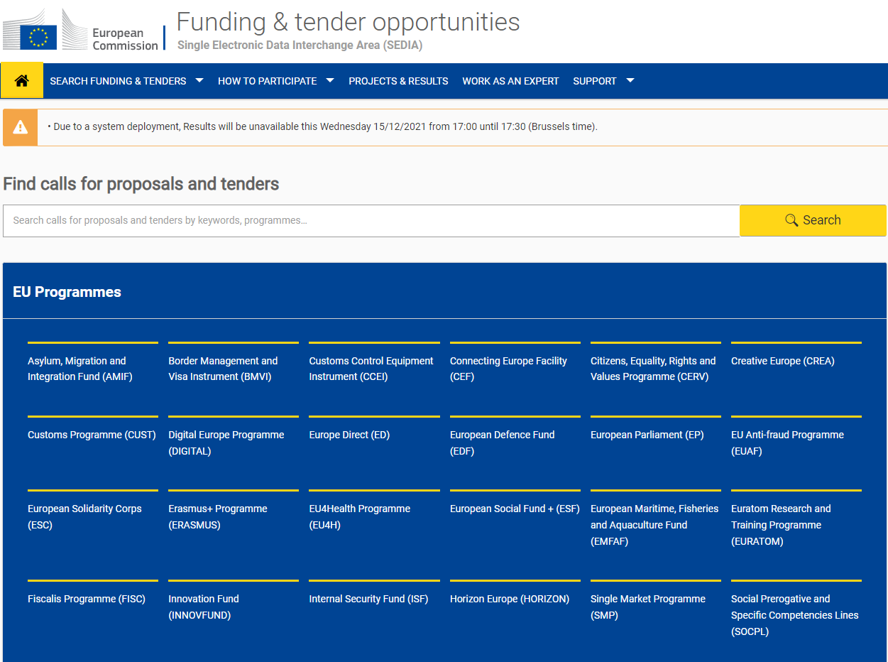

Slide 51
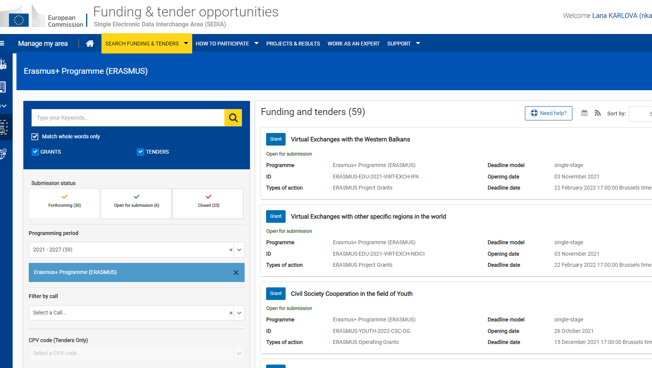

Slide 52
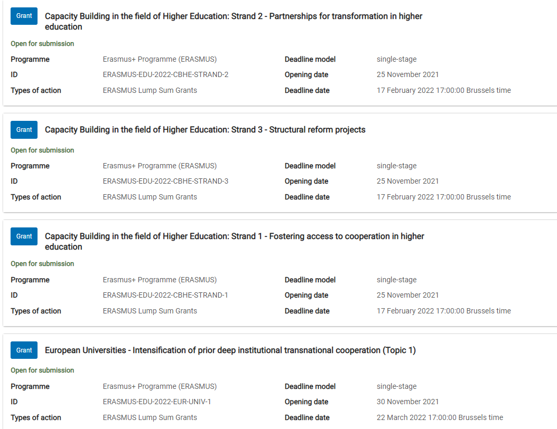

Slide 53
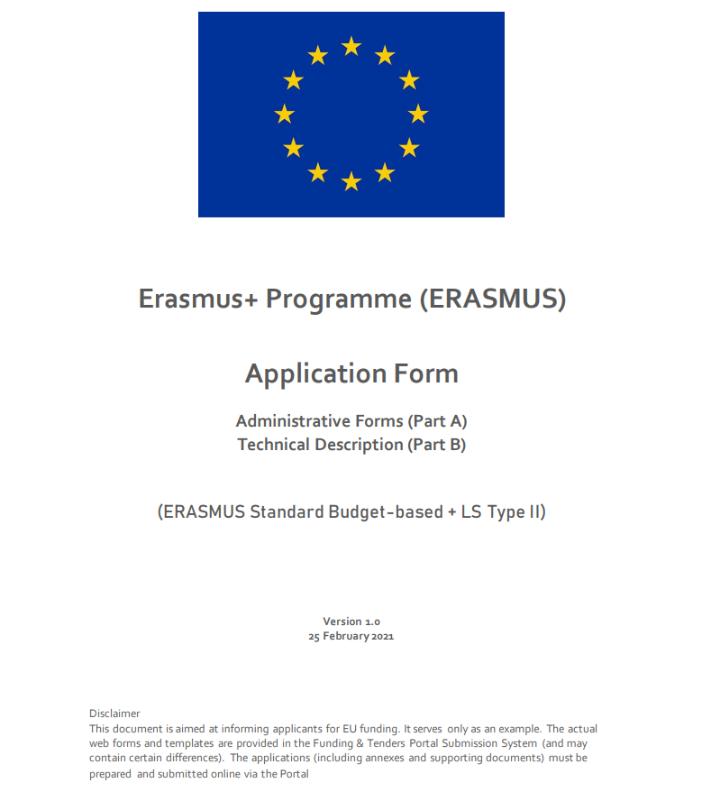

Slide 54
Part A

Slide 55
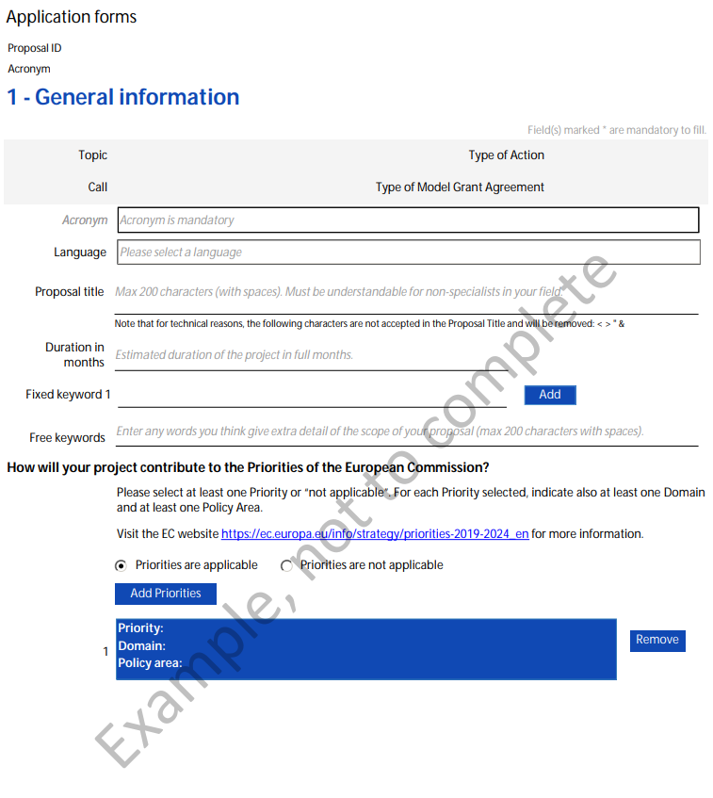

Slide 56
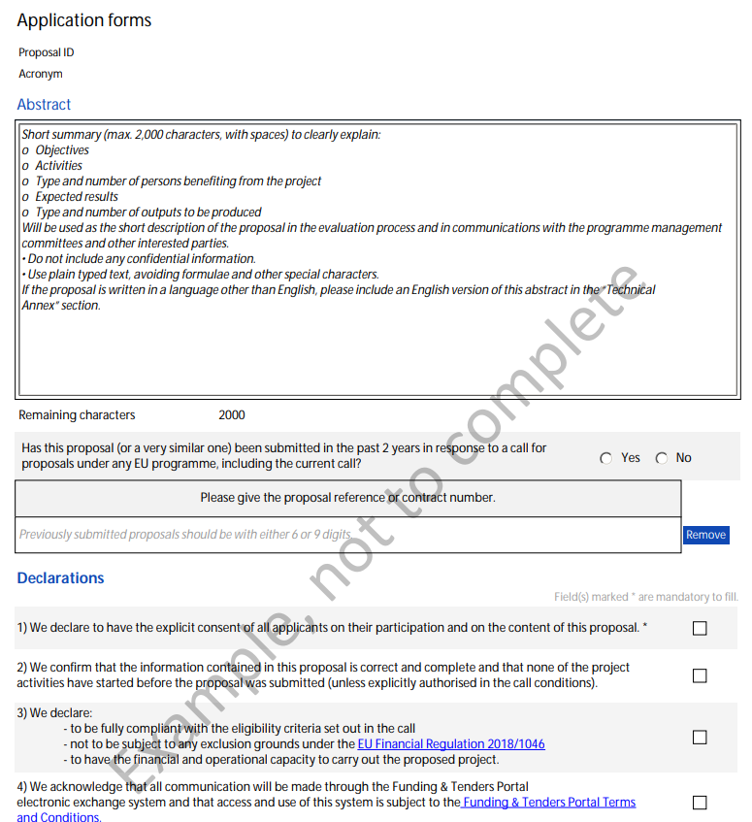

Slide 57
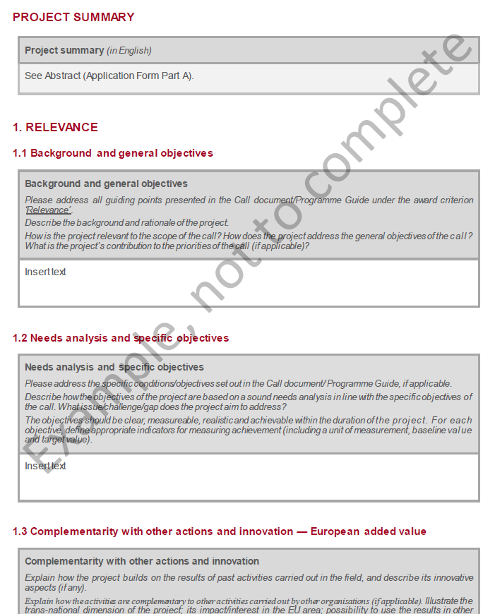

Slide 58
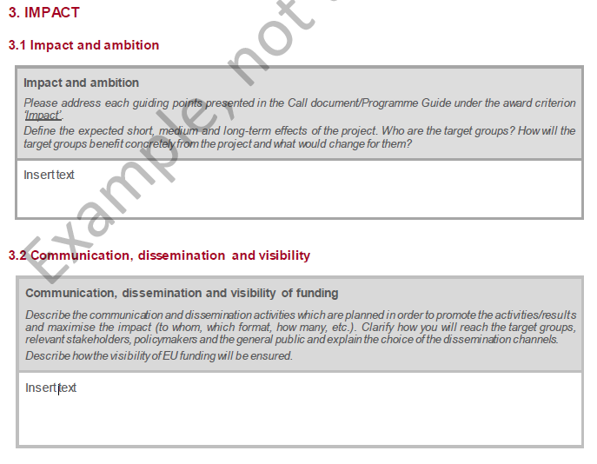
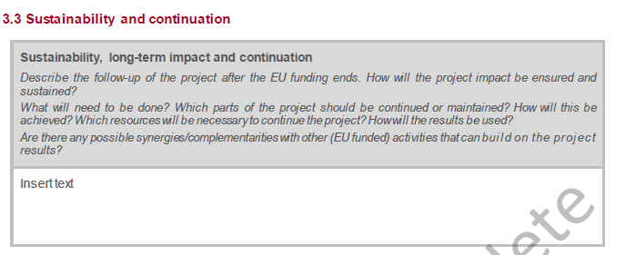

Slide 61
Logical Framework Matrix

Slide 62
Budget

Slide 63
Application & Evaluation Procedure

Slide 64
Award criteria
Relevance of the project
(max 30 points)
Quality of the project design and implementation (max 30 points)
Quality of the partnership and the cooperation arrangements (max 20 points)
Sustainability, impact and dissemination of the expected results (max 20 points)

Slide 65
GUIDE
https://erasmus-plus.ec.europa.eu/sites/default/files/2021-11/2022-erasmusplus-programme-guide.pdf

Slide 66
Get prepared
Read carefully all the call documents: Erasmus+ Programme Guide, application templates and specific instructions published in the FTOP
https://ec.europa.eu/info/funding-tenders/opportunities/portal/screen/home
Read carefully the information on the Regional priorities published in FTOP
Plan your project and define your work plan: Work packages, milestones, deliverables
Create an EU Login account: to able to submit a proposal, you must register on the Portal for an EU Login account
Make sure your organization has a valid Participant Identification Code (PIC). If not, get one via the Participate Register

Slide 67
ON-line session on CBHE
https://webcast.ec.europa.eu/erasmus-capacity-building-in-higher-education-infoday-2021-12-02

Slide 68
DEADLINE
17 February 2022
17:00 - Brussels time = 20:00 Armenian time

Slide 69
https://www.eacea.ec.europa.eu/index_en

Slide 70
https://www.eacea.ec.europa.eu/index_en

Slide 71
WWW.ERASMUSPLUS.AM

Slide 73
THANK YOU
National Erasmus+ Office in Armenia
Tel.: +374 91216258
neo@erasmusplus.am
program@erasmusplus.am
info@erasmusplus.am
www.erasmusplus.am
neoarm
@ErasmusArmenia

