Slide 1
Environmental Considerations in a Competitive Agricultural Sector
Alen Amirkhanian
June 25, 2021

Slide 2
Key Elements
Soil and nutrient
Water
Climate
Biodiversity
Energy
Managing hazardous waste
Circular economy thinking

Slide 3
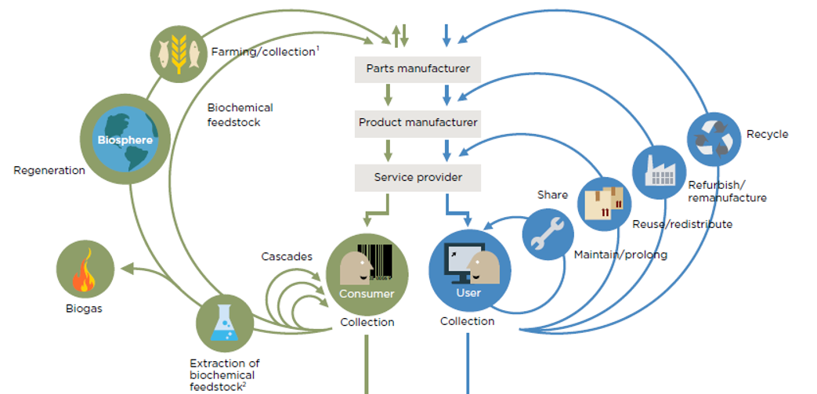
Circular Ecoonomy
ՇՐՋԱՆԱՁԵՎ ՀԱՅԱՍՏԱՆ
Biological flows
Կենսաբանական
նյութեր
Technical flows
Տեխնիկական
նյութեր
10+ Պլաստիկ վերամշակող
5+ Ապակի վերամշակող
ՆՈՐՈԳԻ կահույք
5+ Թուղթ վերամշակող
ՕՌՎԱԿՕ
Վերմիկոմպոստացում և բիո-հումուս
3+ Մետաղ վերամշակող
Ավտոմասերի վերանորոգում
Կապանում պլաստիկից շինանյութ
ՄԵՐ ԵՐԿԻՐԸ
Հյութերի շշեր
ԱՄ-ԷՍԿԱ յուղ
և անվադողեր
վերամշակող
ՇԻՄՈՒՑՈՒ (այրում)
ԼՈՒՍԱԿԵՐՏ
ՓԱՄԲԱԿ 40մ³
Վերանոորոգման կետեր և ծառայություններ
ԱՐԵԳՈՒՆԻ 40մ³
Վարձույթ և համասպառում (sharing)
ԳԵՂԱՄԱՍԱՐ 250մ³
ԷկոԱղբ, ISSD, Apaga

Slide 4
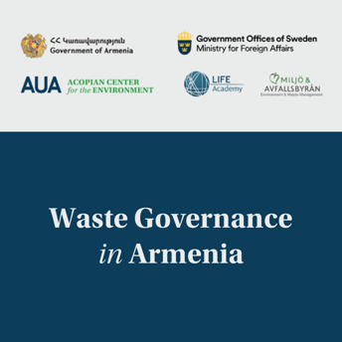
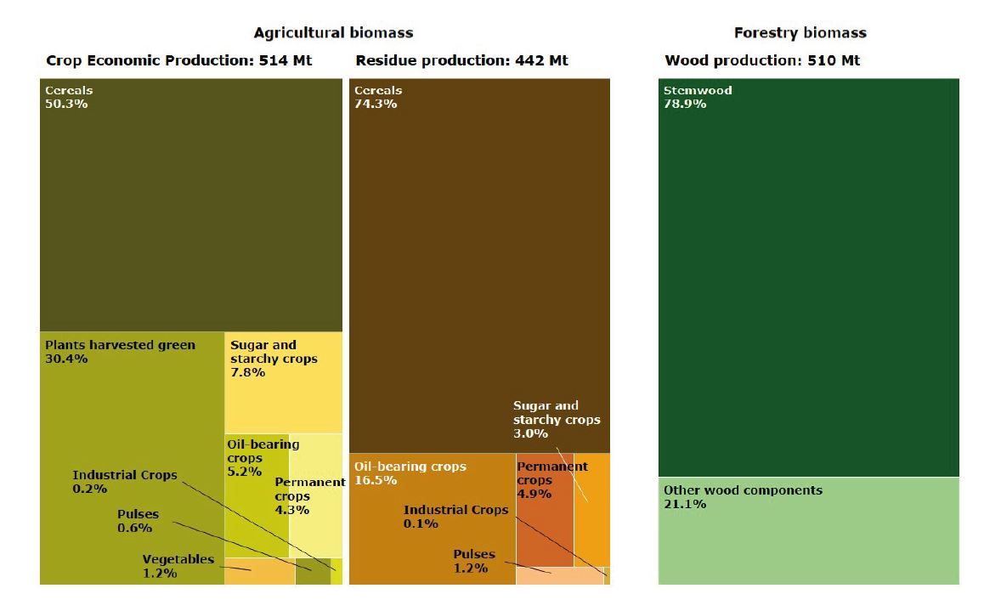
Key Findings
Key findings
Technology and infrastructure
Biological waste treatment infrastructure
10-year average EU-28 annual domestic biomass production from the land-based sectors is 1466 Mtons of dry matter
EU28’s annual agricultural biomass is 956 Mtons.
442 Mtons or 46% of the agricultural biomass is residue that has:
Nutrient recovery value
Energy recovery value
Source: Camia A., Robert N., Jonsson R., Pilli R., García-Condado S., López-Lozano R., van der Velde M., Ronzon T., Gurría P., M’Barek R., Tamosiunas S., Fiore G., Araujo R., Hoepffner N., Marelli L., Giuntoli J., Biomass production, supply, uses and flows in the European Union. First results from an integrated assessment, EUR 28993 EN, Publications Office of the European Union, Luxembourg, 2018, ISBN 978-92-79-77237-5, doi:10.2760/539520, JRC109869

Slide 5
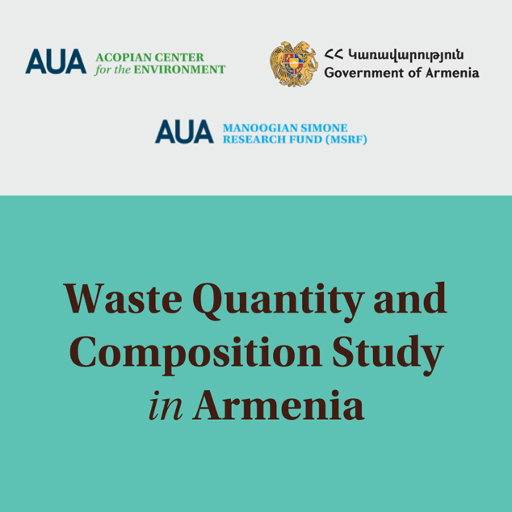
Municipal Solid Waste composition
Country average results
Key Findings
*
(*) Other - wood, textiles, diapers, sanitary napkins, other, not applicable elsewhere)

Slide 6
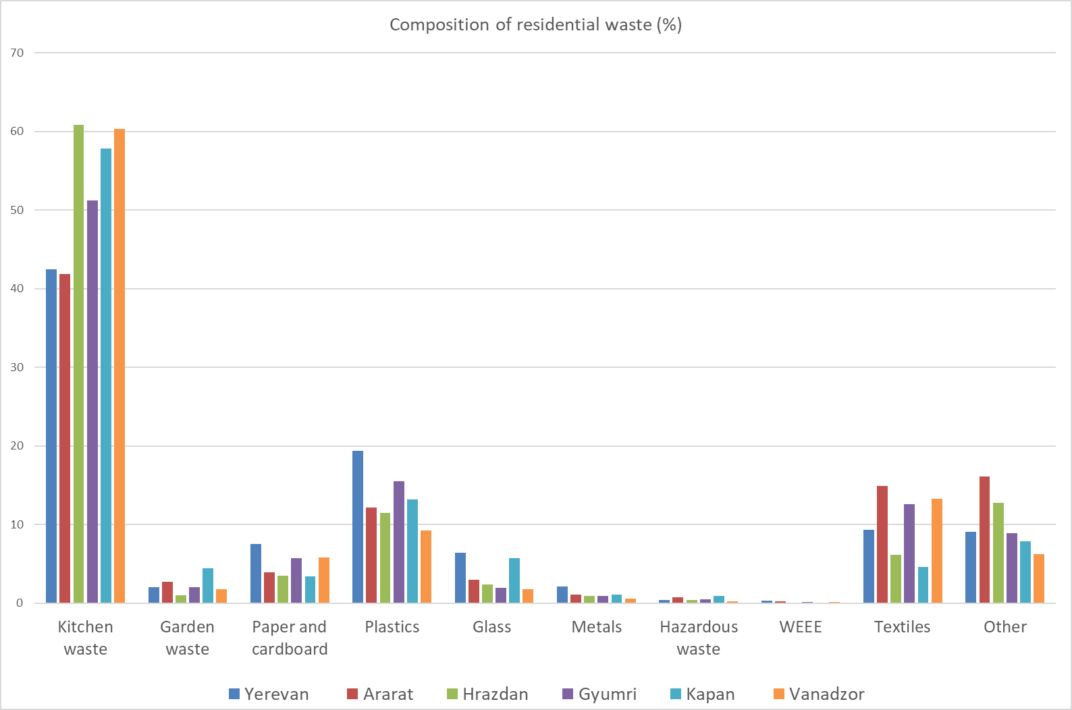
Municipal Solid Waste Composition
Country average results
Key Findings
Composition of residential waste by weight in 6 locations

Slide 7
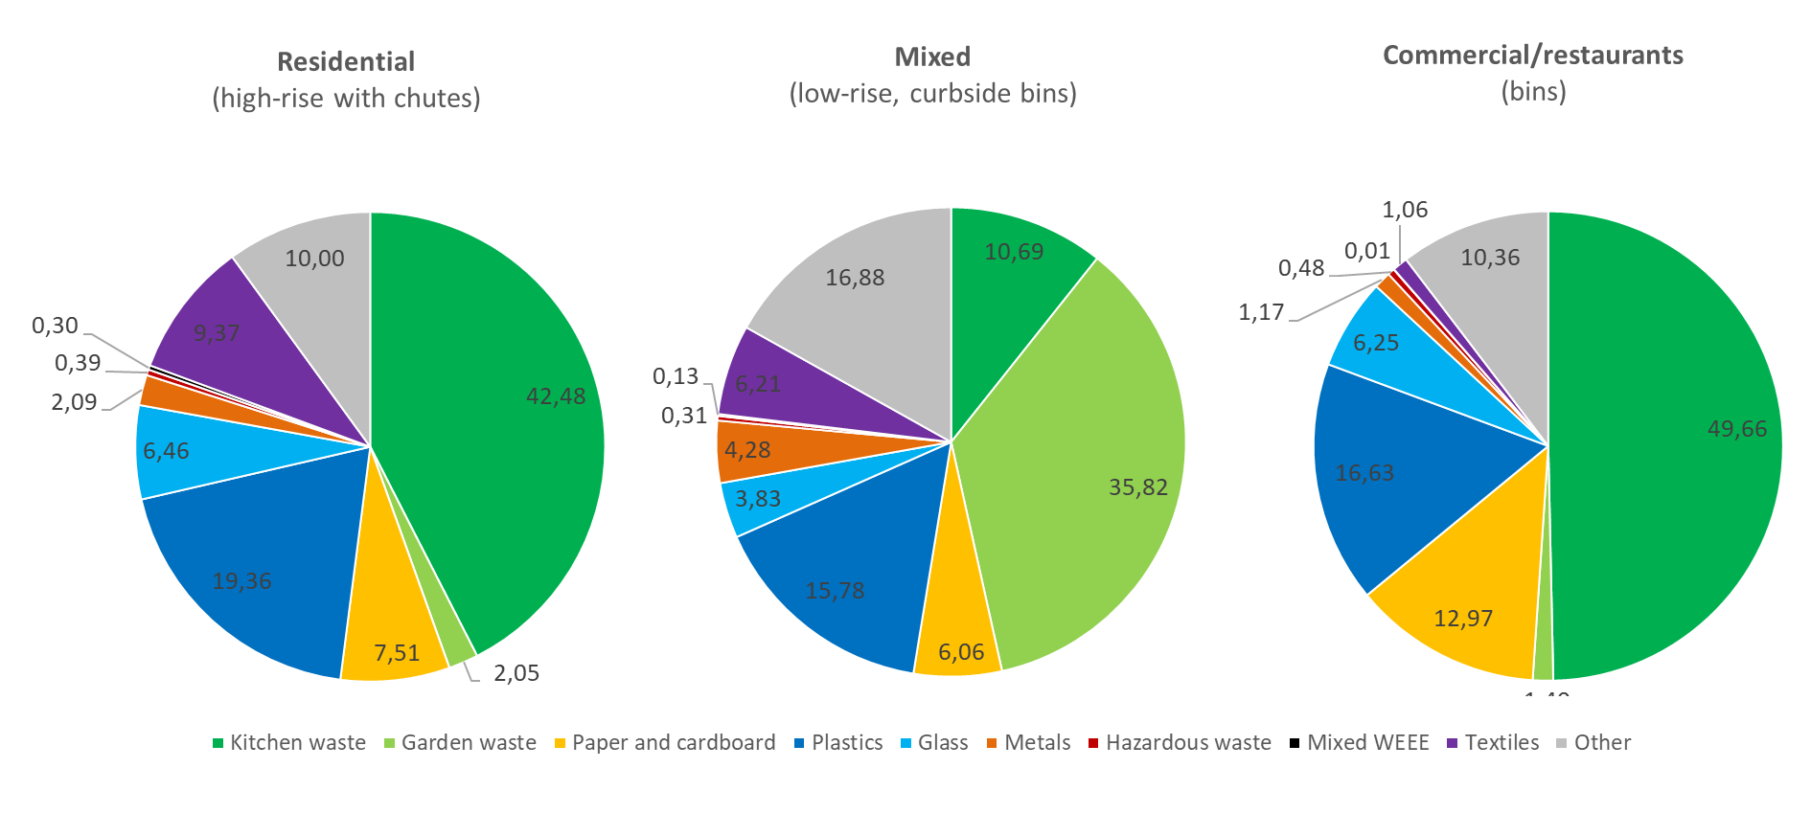
Municipal Solid Waste Composition
Yerevan test results
Key Findings
Waste composition by weight in Yerevan per fraction

Slide 8
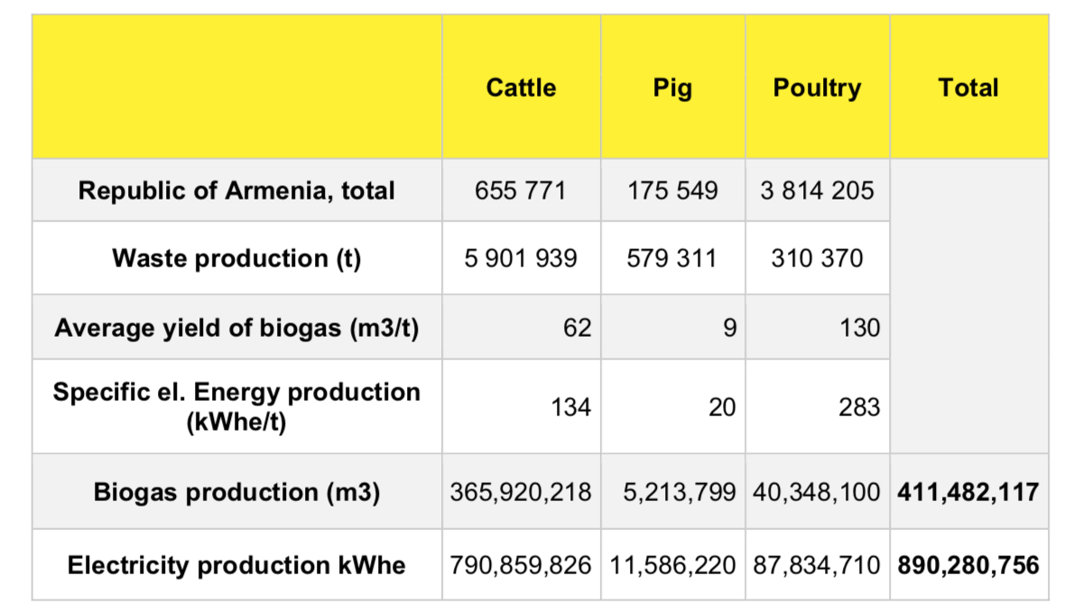
Key Findings
Key findings
Technology and infrastructure
Biological waste treatment infrastructure
BIOGAS POTENTIAL IN ARMENIA
Livestock production in Armenia and estimates for energy recovery through biogas generation:
An estimated 412 million cubic meters of biogas can be produced from livestock waste.
To this estimates for crop reside biogas generation has to be added. No such theoretical estimates exist.
The 412 million cubic meters will be equivalent to about 20% of gas imported to Armenia from Russia annually.
Armenia’s has extensive natural gas utilization infrastructure for transport, heating, and electricity.
After biogas production, the remaining sludge can be used as fertilizer, returning important nutrients back to soil.
Theoretical biogas potential in livestock production in Armenia
Source: Jan Pavlik (2017). Feasibility Assessment of Agricultural Waste-to-Energy Potential and Opportunities for Armenia, UNDP

Slide 9
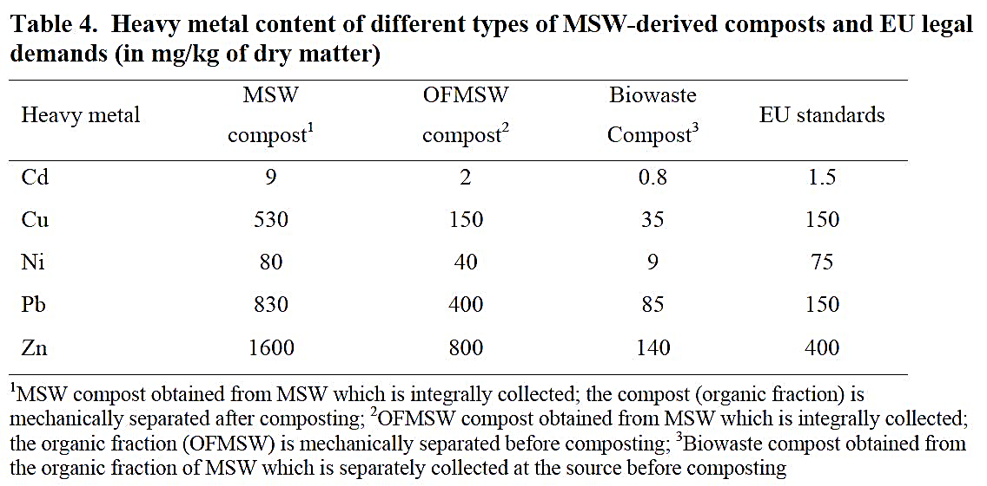
Key Findings
Key findings
Technology and infrastructure
Biological waste treatment infrastructure
No infrastructure for separate food waste collection
Poor infrastructure for farming waste (crop residues, manure, etc.) collection
Missing infrastructure and control results in organic waste disposed in landfills or in nature
Some infrastructure for organic waste aerobic or anaerobic treatment, including
Lusakert Biogas Plant using poultry manure (currently not operating)
Small-scale biogas plants using cow manure in three villages of Gegharkunik
ORWACO using mushroom production waste and manure for vermicomposting and bio-humus production
To use MSW biowaste for fertilizer generation requires source separation. Compelling evidence from the EU!
Heavy metals content of different types of MSW-derived composts and EU legal demands (in mg/kg of dry matter)
Source: Veeken, Adrie & Hamminga, P. & Mingshun, Zhang. (2006). Improving sustainability of municipal solid waste management in China by source separated collection and biological treatment of the organic fraction. Innovative environmental management & sustainable development.

Slide 10
Key Findings
Key findings
Technology and infrastructure
MERCURY Mercury and most of its compounds are extremely toxic and must be handled with care.
The Minamata Convention on Mercury is an international treaty designed to protect human health and the environment from anthropogenic emissions and releases of mercury and mercury compounds. Armenia has joined this Convention, which controls over a myriad of products containing mercury, the manufacture, import and export of which will be altogether prohibited by 2020.
These products include certain types of batteries, compact fluorescent lamps, relays, soaps and cosmetics, thermometers, and blood pressure devices.
Currently in Armenia, the Ministry of Emergency Situations has an official mercury storage site. Also, the Ministry is mandated to respond to citizen calls and requests to remove and dispose mercury containing products or mercury spills.
Mercury risks awareness campaigns are needed. Further efforts and infrastructure on dealing with mercury may be developed as Armenia begins compliance with the Minimata Convention.
Hazardous waste treatment infrastructure
(including WEEE, batteries, mercury lamps, etc.)
No infrastructure to sort out hazardous objects and substances from municipal waste stream
No infrastructure (special landfills) for hazardous waste storage and disposal
Municipal waste contaminated with hazardous substances ends-up in landfills

Slide 11
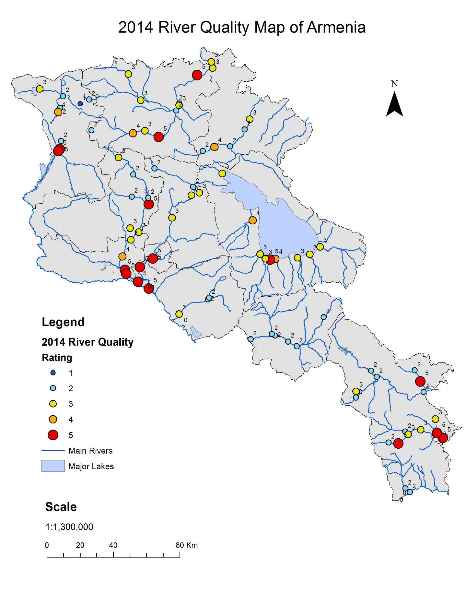
River quality map,
annual averages, 2014
Source: Mapped by the AUA Acopian Center for the Environment using data provided by the Environmental Impact Monitoring Center of the RA Ministry of Nature Protection

Slide 12
European Green Deal
Biodiversity
From Farm to Fork
Sustainable agriculture
Clean energy
Sustainable industry
Building and renovating
Sustainable mobility
Eliminating pollution
Climate action
From Farm to Fork
This focus will identify ways to ensure more sustainable food systems. This includes:
Making sure Europeans have access to healthy, affordable and sustainable food
Tackling food-related climate impact
Protecting the environment and preserving biodiversity
Ensuring a fair economic return in the supply chain
Increasing organic farming
The EU Green Deal has set ambitious targets for making progress toward the above goals. These include:
Taking action to reduce the use and risk of chemical and more hazardous pesticides by 50%
Reducing excess of nutrients in the environment that are a major source of air, soil and water pollution, leading to negative biodiversity and climate impacts. To achieve this, the Commission targets reducing nutrient losses by at least 50% with soil fertility loss and reducing fertilizer use by at least 20%. This is an important part of meeting the aims of, among others, the EU Water Framework Directive and the Nitrates Directive.
Reduce the sale of antimicrobials for farmed animals and in aquaculture by 50%.
By 2030 25 % of total farmland being used for organic farming by 2030.

Slide 13
European Green Deal
Biodiversity
From Farm to Fork
Sustainable agriculture
Clean energy
Sustainable industry
Building and renovating
Sustainable mobility
Eliminating pollution
Climate action
Sustainable agriculture
Sustainability in EU agriculture and rural areas hinges on the EU common agricultural policy (CAP). The CAP aims to ensure that agriculture and forestry in the EU is socially, economically and environmentally sustainable. CAP aims to:
Support farmers and improve agricultural productivity, ensuring a stable supply of affordable food
Safeguard European Union farmers to make a reasonable living
Help tackle climate change and the sustainable management of natural resources
Maintain rural areas and landscapes across the EU
Keep the rural economy alive by promoting jobs in farming, agri-foods industries and associated sectors

Slide 14
European Green Deal
Eliminating pollution
Measures will be put in place to cut pollution rapidly and efficiently. To protect Europe’s citizens and ecosystems, the Commission will adopt the zero-pollution action plan to prevent pollution of air, water and soil (Eliminating Pollution: The European Green Deal, December 2020).
Clean Water
Preserve biodiversity in our lakes, rivers and wetlands
Reduce pollution from excess nutrients thanks to the Farm to Fork strategy
Reduce particularly harmful pollution from micro-plastics and pharmaceuticals
Clean Air
Review air quality standards in line with the World Health Organization guidelines
Support to local authorities to achieve cleaner air for our citizens
Industry
Reduce pollution from large industrial installations
Improve prevention of industrial accidents
Chemicals
Protect citizens against dangerous chemicals with a new chemicals strategy for sustainability for a toxic-free environment
Combine better health protection with increased global competitiveness
Develop more sustainable alternatives
Improve rules on assessment of substances launched on the market
Biodiversity
From Farm to Fork
Sustainable agriculture
Clean energy
Sustainable industry
Building and renovating
Sustainable mobility
Eliminating pollution
Climate action

Slide 15
Integrated Landscape Management –
a 3-day conference in October 2021
(part of our GAtES project with the University of Hohenheim)
AGENDA
Day 1 & 2 -- October 4-5
Keynote 1
Speaker: Sara Scherr, EcoAgriculture Partners, Oakton, Virginia, U.S.
Topic: Integrated Landscape Management and Ecoagriculture: An Inclusive Approach to Sustainable Development
Questions that would interest an Armenian policy audience: How do we ensure exponential economic growth that is socially inclusive and environmentally caring? What policy, legal, and institutional changes are needed? Are there special technologies or know-how required?
Keynote 2
Speaker: Prof. Dr. Joern Fischer, Leuphana University of Lüneburg, Germany
Topic: Sustainable Landscapes and the Socio-Ecological Approach: Participatory Success in Post-Communist Romania
Questions to be addressed could include: what is the value of the socio-ecological approach; how can scientific research have real, short/medium-term social and environmental impact; how does the researcher establish trust?
Keynote 3
Speaker: Prof. Nora Fagerholm, University of Turku, Finland
Topic: Urban Landscapes and Green Infrastructure: Impact of 3D Public Participation GIS
Questions to be addressed could include: How can such technologies be used to create impact at the community level? For instance, what landscapes and urban green infrastructures offer in terms of ecosystem services and nature-based solutions the benefits of which communities value (e.g., human wellbeing)? How do these tools help with better environmental planning, e.g., better conceptualizing and planning the urban/nonurban landscape continuum? How effective are these tools for a transdisciplinary approach, integrating urban dwellers and multiple stakeholders? How new techs can be applied to participatory methods in order to create an impact in decision making and management at a community level?
Day 3 -- October 6 (STUDENT DAY)

