Slide 1
How to boost agricultural exports in Armenia Export Investments in Armenia: Barriers and Challenges Dr. Vardan Urutyan Rector, ANAU

Slide 2
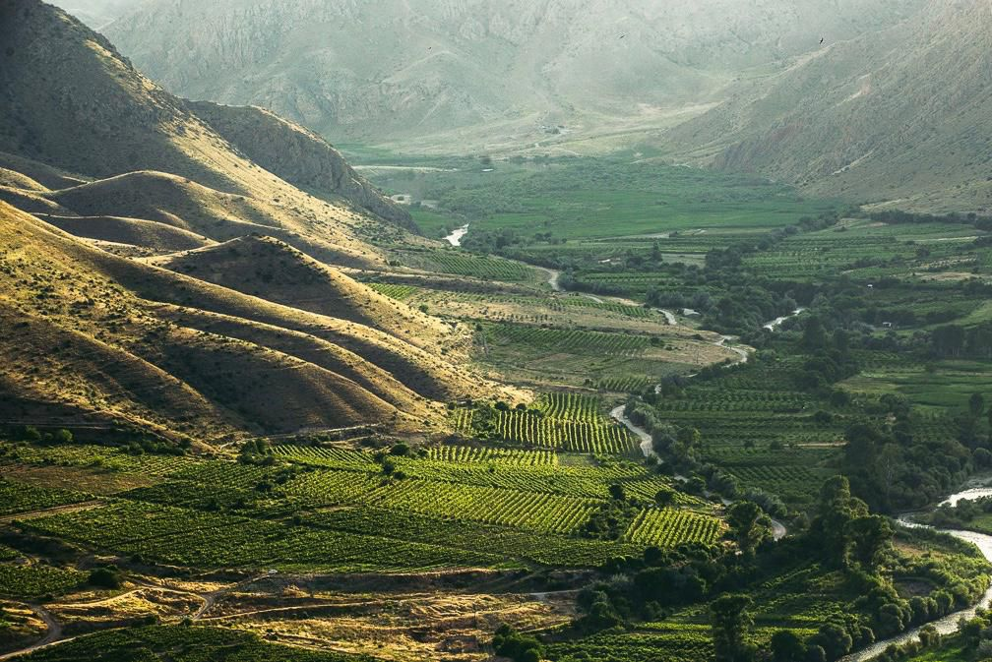
Gross Agricultural Output in 2020
1.7 billion USD – 13.2% of GDP
53%
Animal Husbandry
47%
Crop Production
Source: RA National Statistical Committee

Slide 3
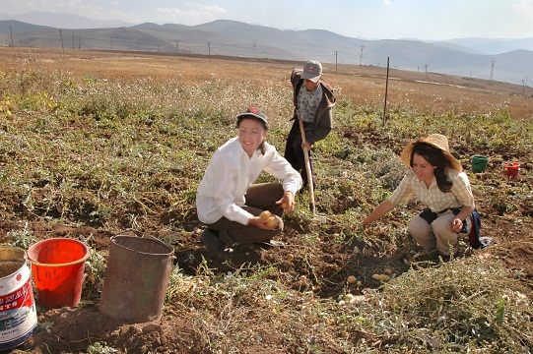
Employment in Agriculture
22% of total employment in 2019
Source: National Statistical Committee of Republic of Armenia

Slide 4
Limitations
Low Level of Productivity and Efficiency
Large-scale application of traditional methods and technologies of agricultural activities
Low level of technical re-equipment and upgrades
Assurance of Food Security, low level of Food Safety
Poor Professional Development
Poorly developed infrastructures
Inefficient use of agricultural land

Slide 5
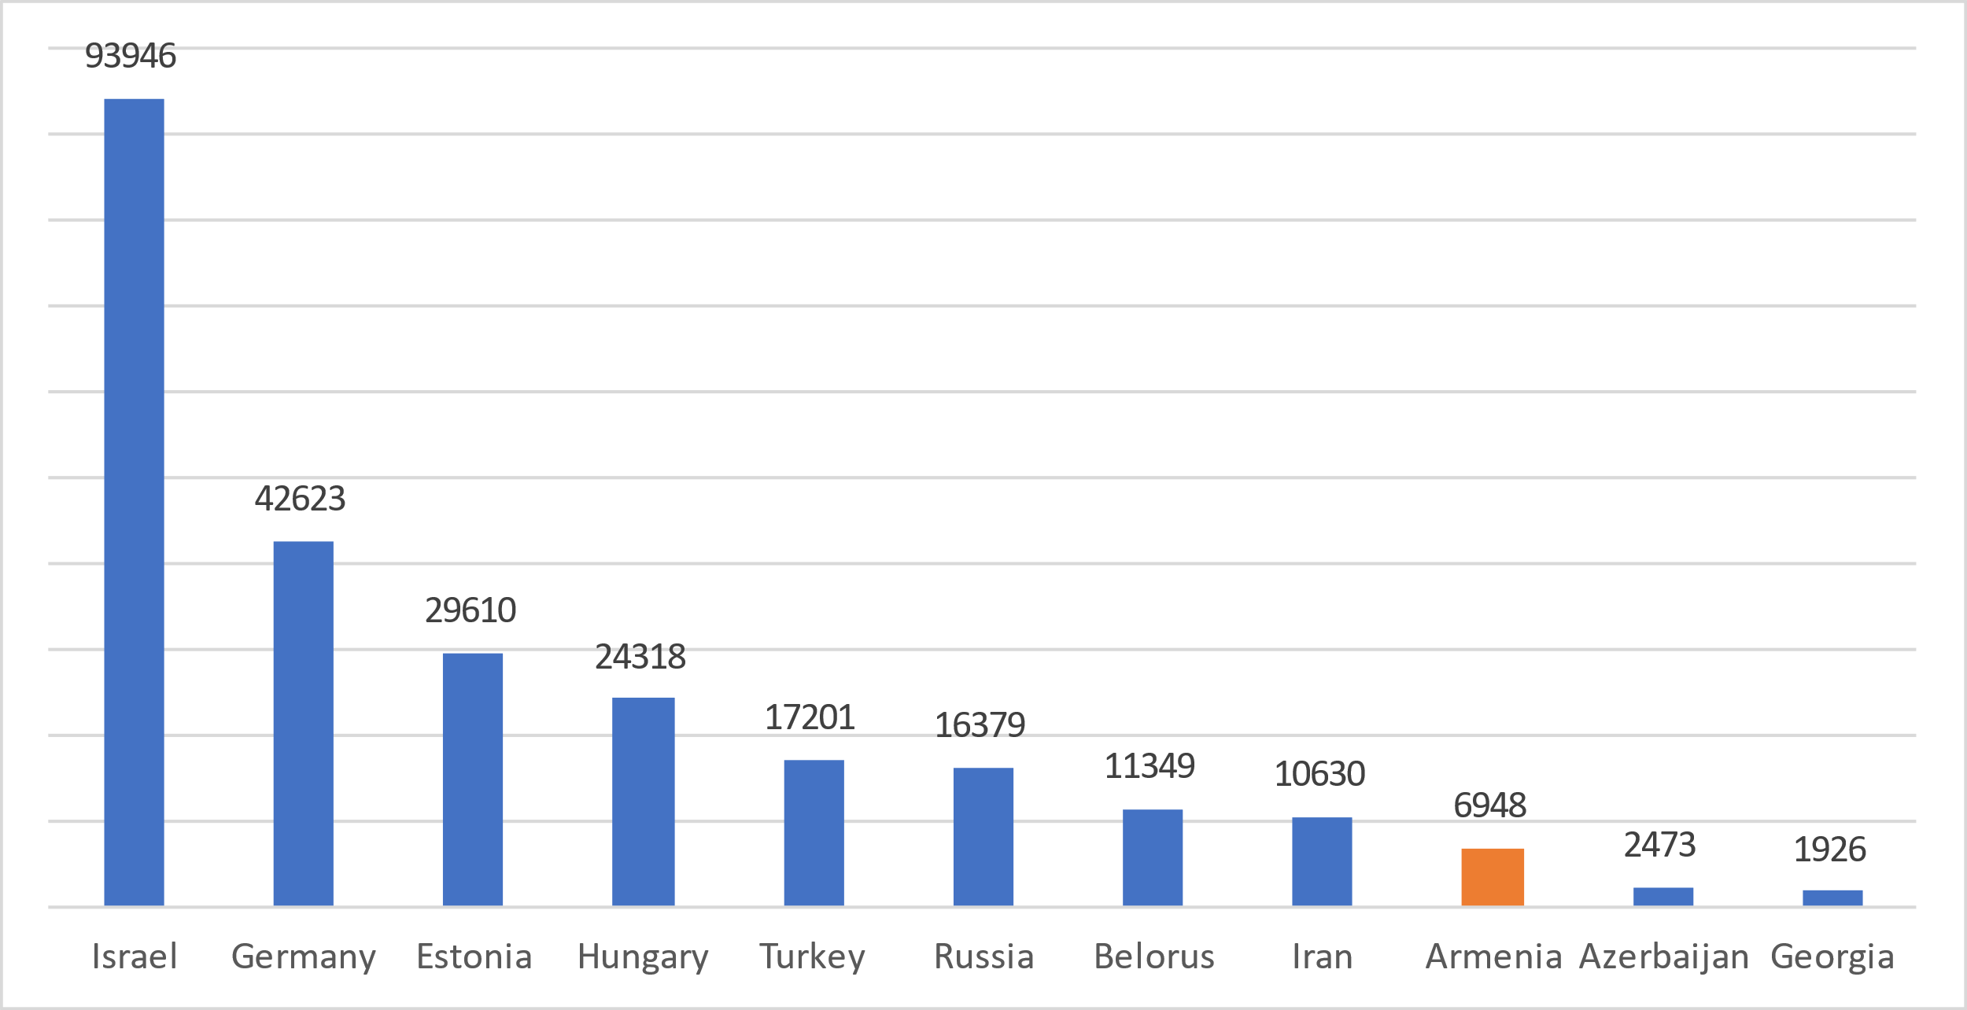
Agriculture Value Added Per worker (2019, USD)
Derived using World Bank national accounts data and OECD National Accounts data files, and employment data from International Labour Organization, ILOSTAT.

Slide 6
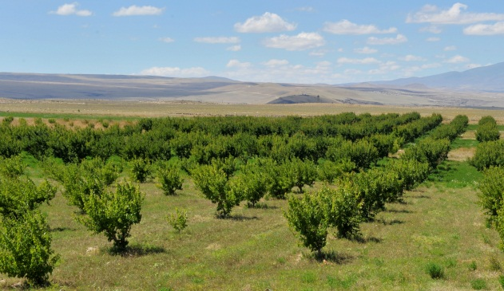
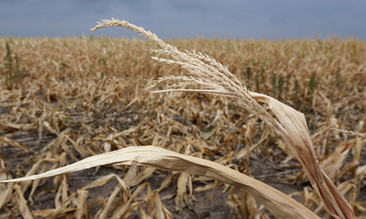
Agricultural Land Use
The reason behind non targeted use of land
Insufficient supply of irrigation water
Low profitability
Lack of agricultural equipment,
Absence of land owner or land user
Low soil fertility
Marketing and sales difficulties
Small and fragmented land plots (avg size 1.48 ha)
……
Around 220,000 ha arable land is not cultivated
Only 55% of hay-meadows are mown
More than 65% of pastures are not fully used
Non targeted use of agricultural land – 50%

Slide 7
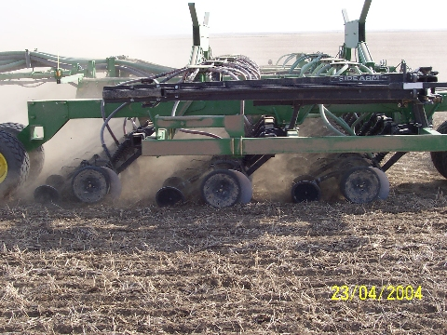
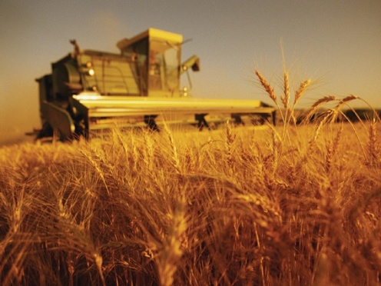
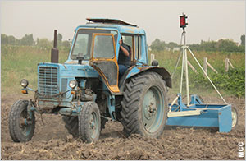
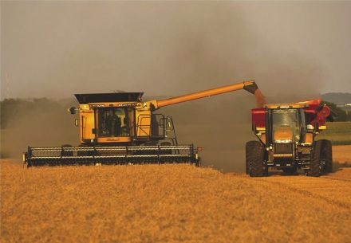
Agricultural Machinery Use
The availability of the functioning machinery per 100 farms constitutes 3.5% for tractors, 1.6% for tractor trailers, 0.9% for ploughs, 0.5% for row planters, 0.5% for grass mowers, and 0.4% for balers.
Poor conditions of available farm machinery, high needs of spare parts, 95% of tractors are exploited more than 10 years.
Additional 1,200 tractor trailers, 3,600 ploughs, 600 row planters, 2,000 grass mowers, and 1,500 hay/straw balers are needed to fully equip with farm implements just the tractors currently in use at the farms.

Slide 8
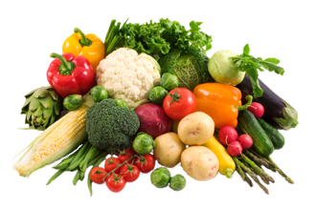
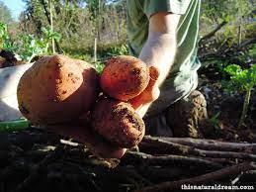
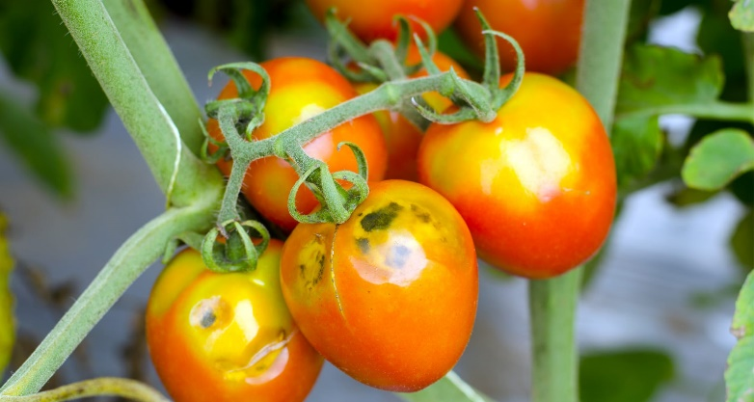
Food Waste and Loss Across the Supply Chain in Armenia
 | Ag. production | Post-harvest handling and storage | Processing and packaging | Distribution | Consumption at household level
Cereals | 15% | 5% | 6% | 7% | 5%
Roots & Tubers | 19% | 6% | 0% | 3% | 1%
F&V | 10% | 4% | 3% | 10% | 3%
Meat (Beef) | 1% | 0.1% | 1% | 1% | 1%
Fish and Seafood | 20% | 0.1% | 0.2% | 3% | 1%
Milk | 2% | 0.1% | 4% | 2% | 1%
Eggs | 23% | 1% | 0.1% | 0.1% | 0.1%
Source: Country study on Food W&L: Armenia, 2013 – Urutyan V.
Estimated total wastes and losses in some products across the supply chain
Wheat – 128,000 tons Potato - 66,000 tons Tomatoes - 28,000 tons Apples - 10,000 tons Milk - 67,000 tons

Slide 9
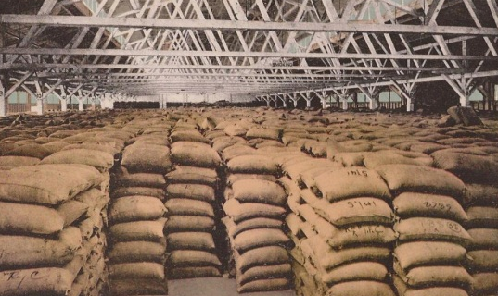
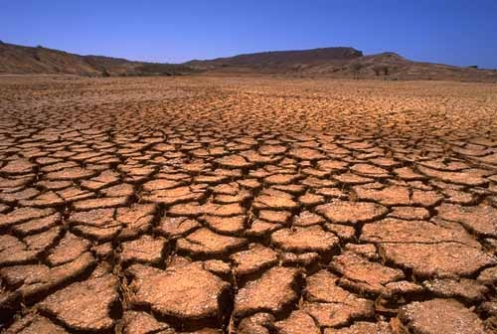
Food Security Situation, 2019
Self-sufficiency ratios
Fruits 104.0 %
Vegetables 102.4 %
Potato 101.1 %
Lamb and goat meat 113.8 %
Egg 100.0 %
Fish 113.1 %
Milk 84.3 %
Beef 90.4%
Wheat 25.9%
Corn 26.5 %
Pork 55.5 %
Poultry 21.7 %
Vegetables oil 1.5%
Leguminous crops 38.2%

Slide 10
There is a considerable untapped potential in the Armenian agriculture and food industry for boosting agricultural exports and attracting investments !!!

Slide 11
Increasing the land utilization and productivity are the key pillars for Armenia’s agricultural growth!!
Yield on food security-crucial products (meat, dairy and cereal) falls behind…
wheat by 380%, cow milk by 280%, beef by 250%, sheep meat by 190%,
Utilization of advanced seeds and crop protection will improve the yield. Even with limitations related to high land fragmentation there is still room to improve productivity by more than 4 times.
Effective land reform, creation of land bank, and incentivizing cooperation among small farmers.

Slide 12
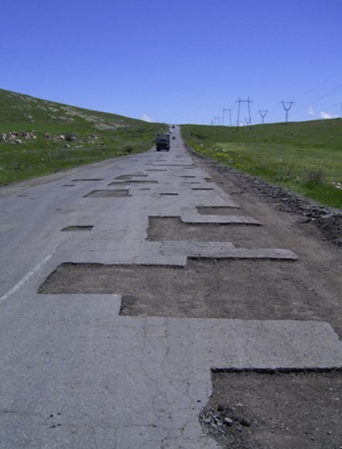
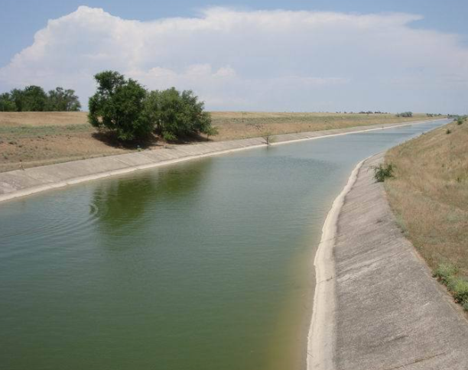
Improvement of Infrastructure
Largest impact can be achieved by building/modernizing roads to key agricultural hubs, Georgian and Iranian border
Irrigation systems are crucial to improve yields
Combination of rainwater collection and surface water channels, smart irrigation systems

Slide 13
Potential to unlock additional $2.5 billion in gross agricultural output.
Agricultural export has a potential to grow by 5 times within 10-15 years

Slide 14
The Role of Cooperatives
Cooperatives are a driving force for sustainable and inclusive development and can play an important role in boosting agricultural exports.
Globally, there are more than 3 mln cooperatives and credit unions, representing more than 1 bln members.
The success of farmers and other value chain actors frequently depends upon their ability to work together through institutions able both to address local and export markets and to provide the strength to meet the challenge of multinational competitors — often even in their home markets.
particularly important in the sphere of primary agricultural produce and agro-industrial products

Slide 15
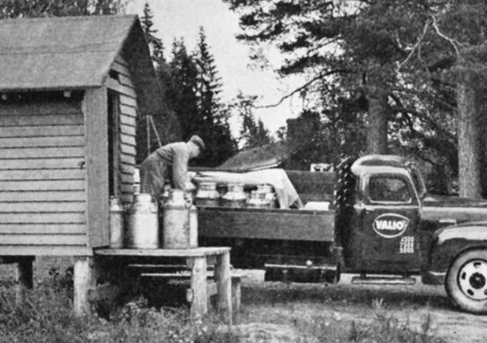
Case of Valio
Started as a cooperative in 1910 with 150 dairy farmers
Valio has roughly 4,300 dairy farmers that own the company through 14 cooperatives.
Member farmers and Valio itself employ an estimated 30,000 people.
Valio is the most important customer for over 350 small and mid-sized businesses all around Finland.
Valio’s dairy farms produce roughly 80% of Finnish milk.

Slide 16
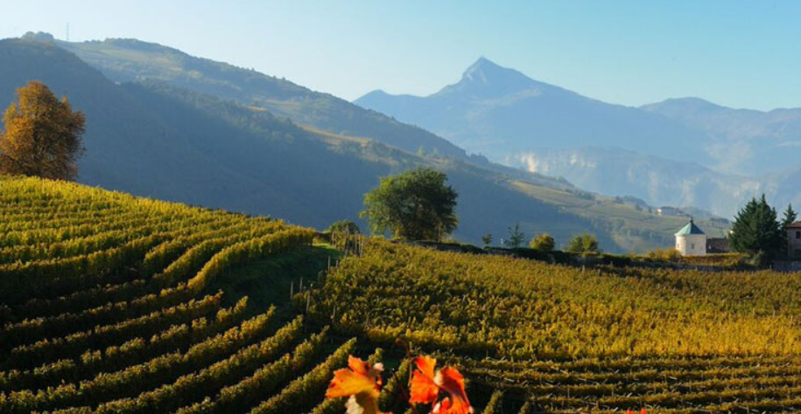
Case of Cavit
Cooperative group that incorporates
11 cooperative wineries in Trentino.
Started in 1950 as a cooperative of winegrowers.
The first winery was opened in 1957.
6.350 hectares of vineyards, 5.250 winegrowers

Slide 17
Obstacles hindering the development of coop movement in Armenia
poor understanding of true cooperative identity and cooperative principles among farmers,
lack of participation of farmers in economic activity of cooperatives,
lack of understanding of the cooperative governance and management,
many cooperatives only exist on paper and rely on donor support.
confusion of business type cooperative entities with Soviet “Kolkhozes” (state collective farms).
lack of support from government, poor understanding of cooperative identity and its impact on economy among the government officials, e.g. Ministry of Finance and State Revenue Committee.
discrepancies in the existing cooperative laws.
The new Law on Agricultural Cooperatives has been accepted in December 2015 (based on Principles of European Cooperative Laws (PECOL). It is expected that this law will widely contribute to the development of cooperative movement in the country; however additional legal acts and revisions in the tax laws are needed to finalize the reformation process.

Slide 18
The role of rural extension services in export promotion and attracting investments
Agricultural extension and advisory services play a crucial role in
boosting agricultural productivity
increasing food security
improving rural livelihoods, and
promoting agriculture as an engine of pro-poor economic growth.
Agricultural extension services globally are face with a challenge to become more effective and responsive.
Currently, Armenian rural advisory and extension services lack both effectiveness and outreach due to the insufficient number, knowledge and capacity of extension agents.

Slide 19
A new model of effective and inclusive rural advisory and extension service is needed!
Increasing the value of agricultural exports by improving quality and increasing production volumes by developing advanced extension services.
Providing critical support service for rural producers and actors along the value chain for meeting the new challenges confronting agriculture:
transformation in the global food and agricultural system,
including the rise of supermarkets and the growing importance of standards, labels, and food safety;
increase in urbanization
constraints imposed by Covid-19 and other shocks that affect rural livelihoods;
and the deterioration of the natural resource base and climate change.

Slide 20
From extension agents to innovation brokers!
High profiled experts with extensive systemic knowledge
Able to provide knowledge on farm business plans and financial literacy for farmers
Project management skills, softs skills
Ability to link farmers to local and export markets and provide market/price information
Presenting strategies for sustainable utilization of available resources
bridging communication gaps between various actors of innovation systems – linking farmers to academia and policy actors
Suggesting solutions adapted to the needs of farmers and industry, and thus impact on innovation adoption

Slide 21
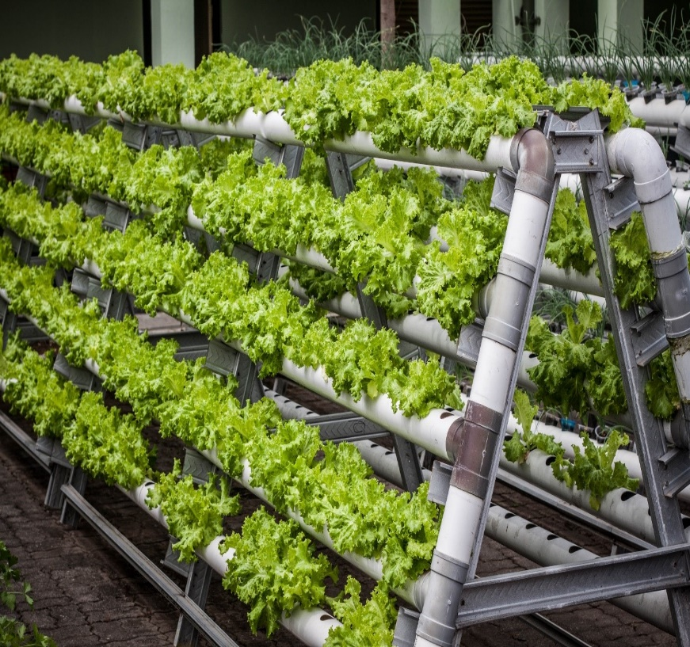
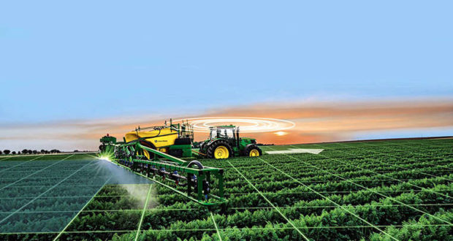
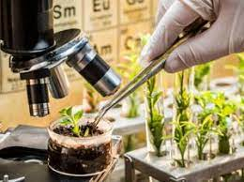
Agriculture 4.0
Agri bots
IoT
Smart farming
New stage of technological development
The global AgriTech Market in 2019 - $17.4 bln.
Projected to reach $41 bln. by 2027
Source: April 2021 www.researchandmarkets.com
Vertical farming
Precision agriculture
Biotech

Slide 22
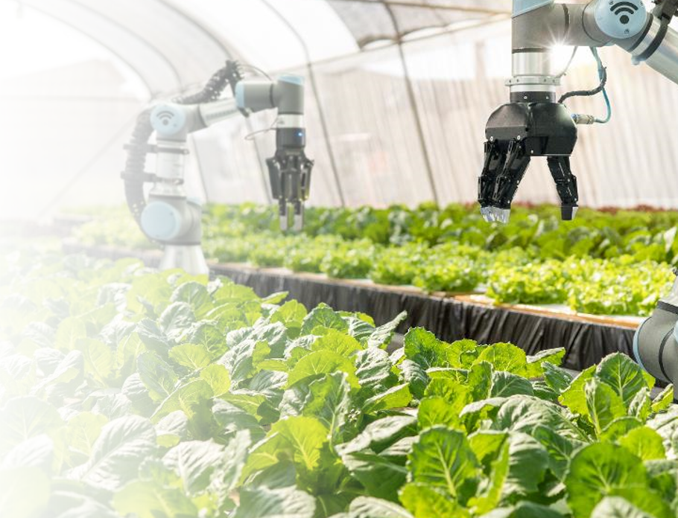
Agriculture 4.0
Requires high level of applied science and human capital
Requires effective dialogue between large agribusinesses, scientific institutions and the State.

Slide 23
Thanks for your attention !!

